Slide 1

Spatially dense air pollutant sampling: Implications of spatial variability on the representativeness of stationary air pollutant monitors
Hugh Li¹, Peishi Gu¹, Qing Ye¹, Naomi Zimmerman¹, Ellis Robinson¹, R. Subramanian¹, Joshua Apte², Allen Robinson¹, Albert A. Presto¹
¹Center for Atmospheric Particle Studies, Carnegie Mellon University, Pittsburgh, PA 15213
²Department of Civil, Architectural and Environmental Engineering, The University of Texas at Austin, Austin TX 78712

Slide 2
Objective
Spatial variation of NO₂, UFP, and PM₁
Use modifiable factors to describe pollutants’ spatial variation
Spatial representativeness of monitors in a variety of neighborhoods

Slide 3
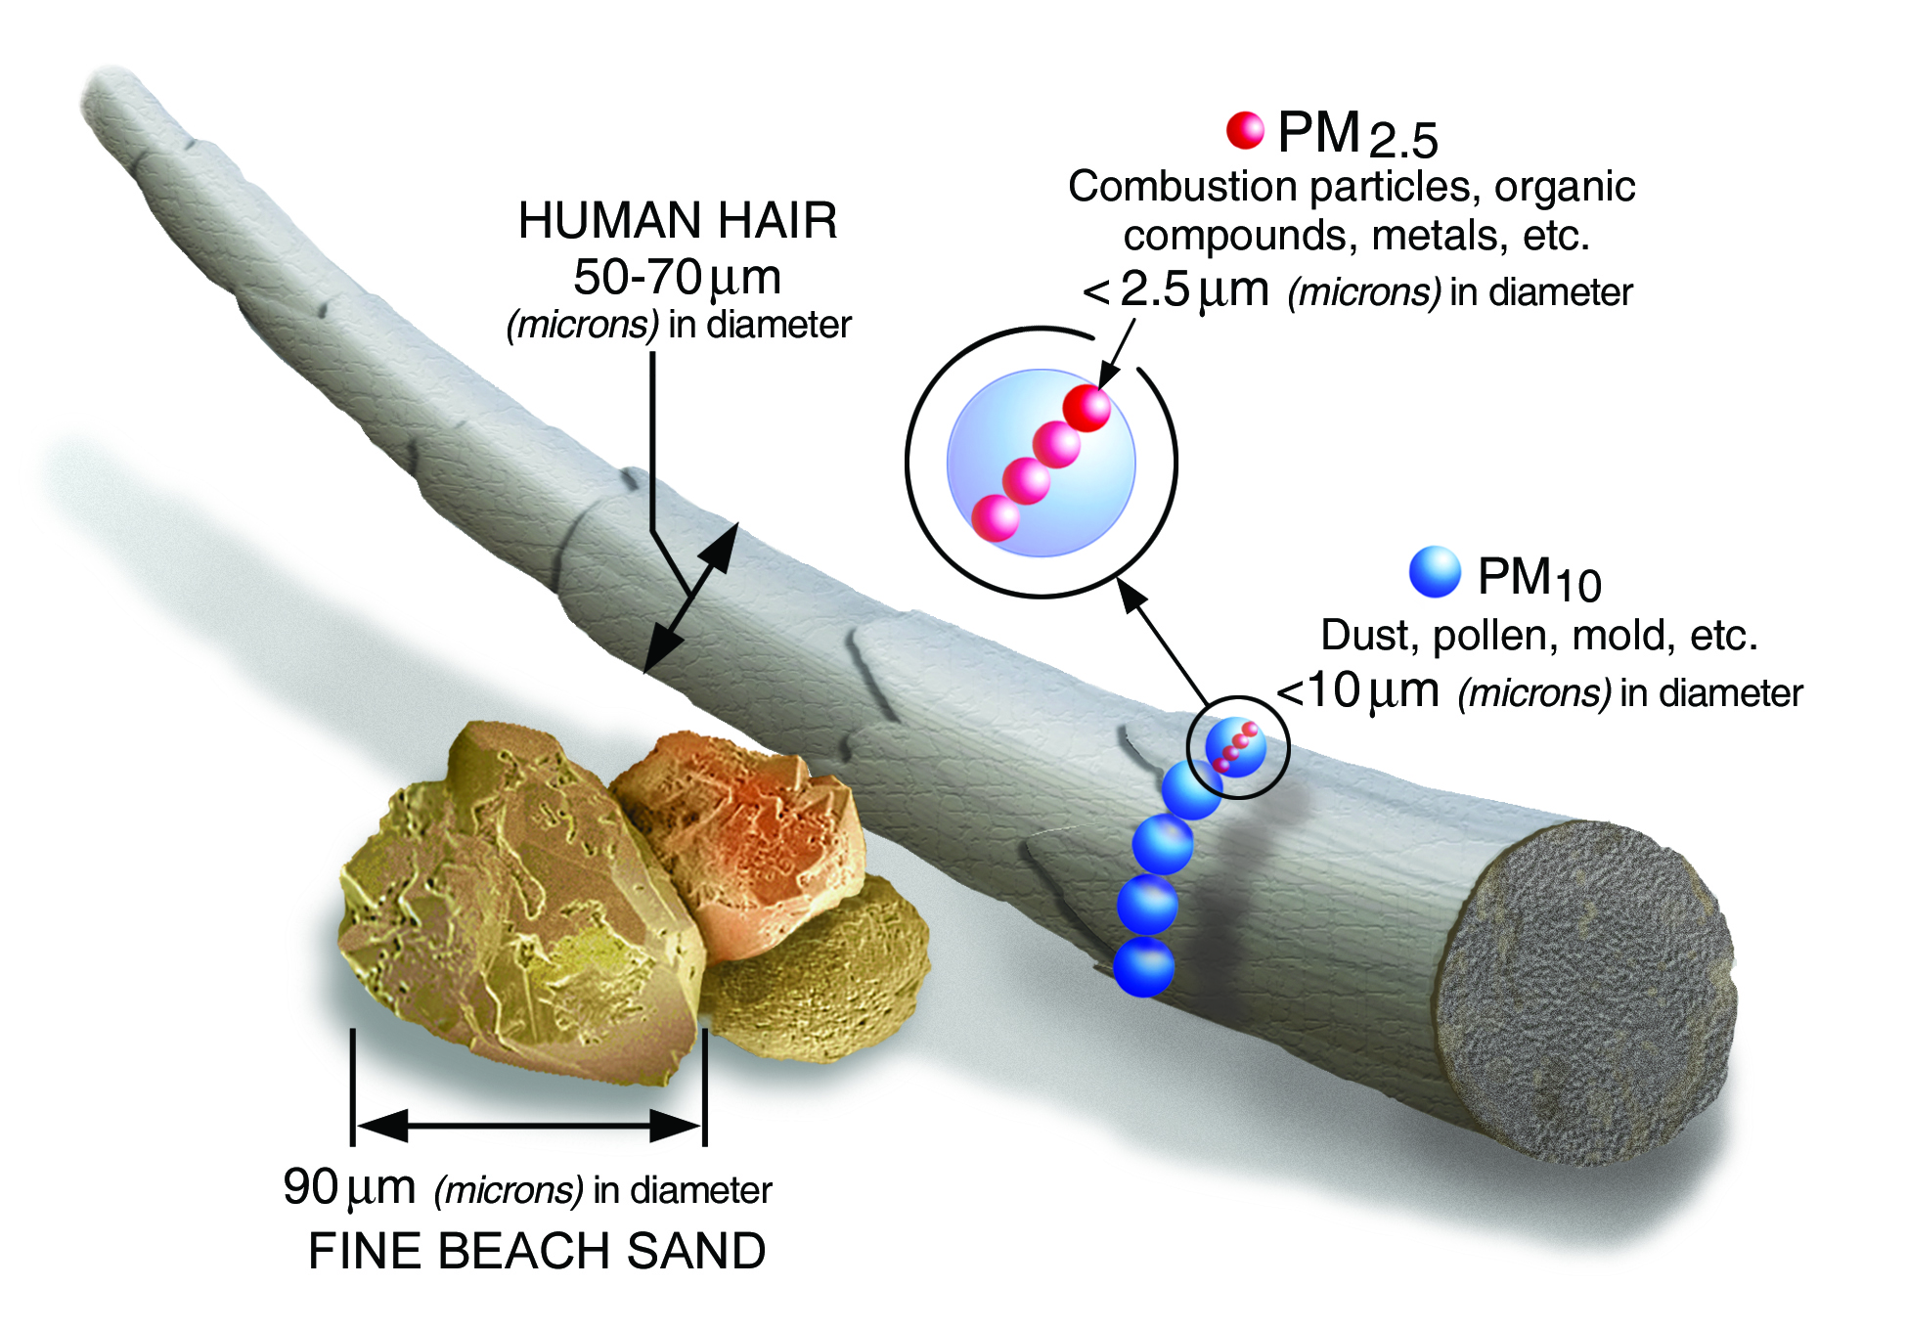
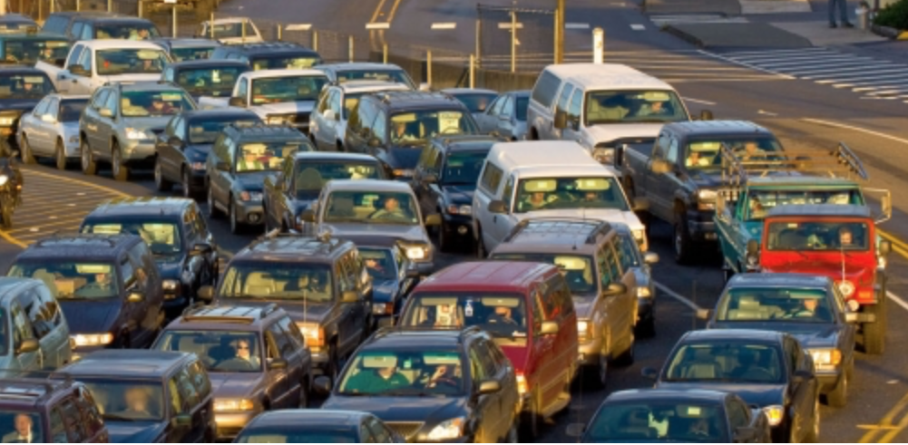
Airborne gas and particle pollutants
Nitrogen dioxide (NO₂)
EPA.gov
Notes:
they are tiny;
EPA set standards for them

Slide 4
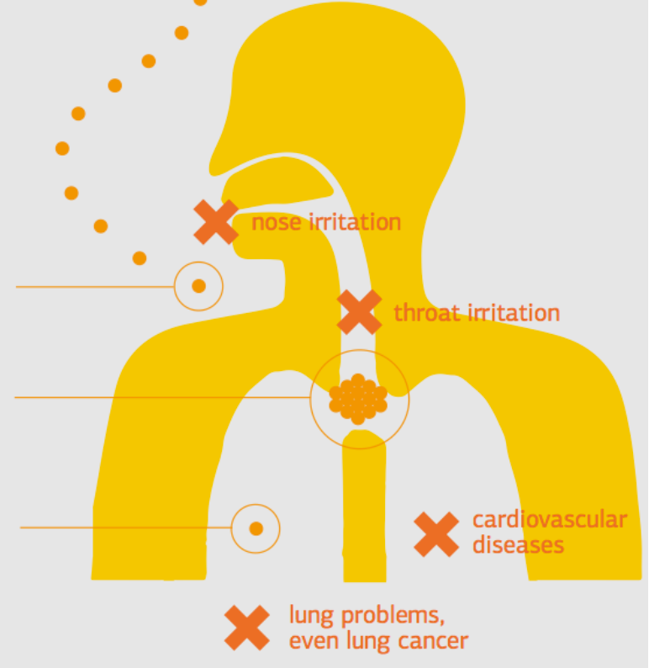
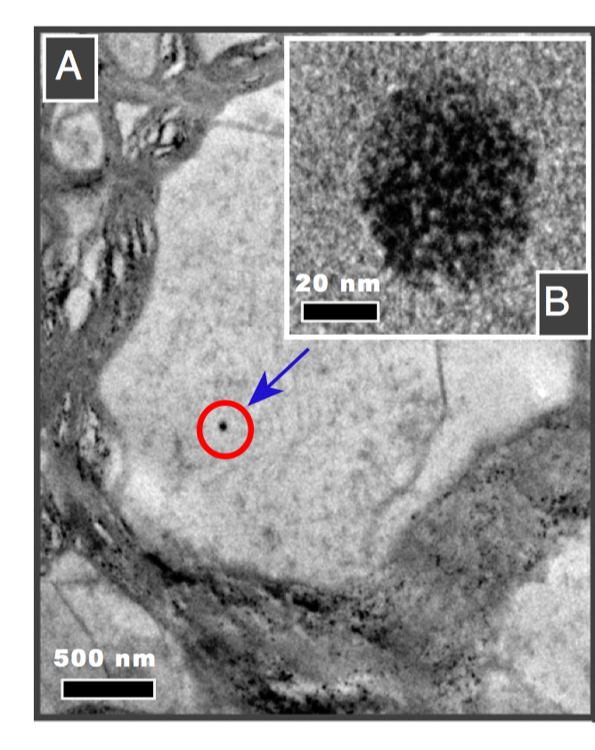
Ultrafine particles (UFP, Da < 0.1 µm) found inside brain
Environment-assured.com
Maher et al., 2016
Notes:
Ultrafine a new interest, it’s the fraction xxx;
Small size, penetrate through cell membranes, body organs
Transmission electron microscopy

Slide 5
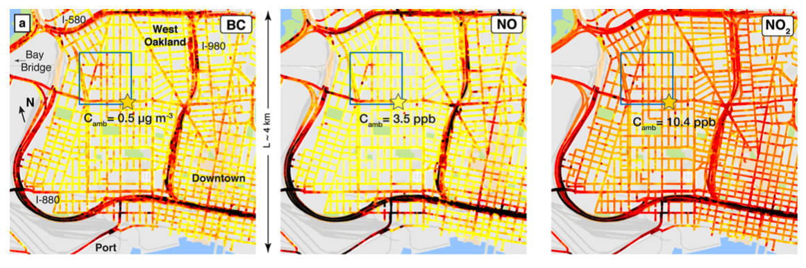
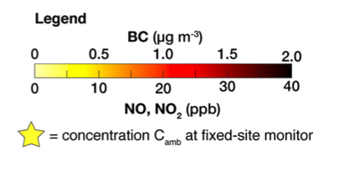
Do regulatory monitors represent air pollution in their surrounding areas well?
4 km
Apte et al., 2017
Notes:
They are toxic and here comes another problem, variable;
Here I am showing you the spatial variation of BC, NO, NO2 with mobile sampling using google street view vehicle;
Say here monitors might not represent areas far away

Slide 6
Is it ok for CTM or remote sensing to use monitors to represent a whole pixel?

Slide 7
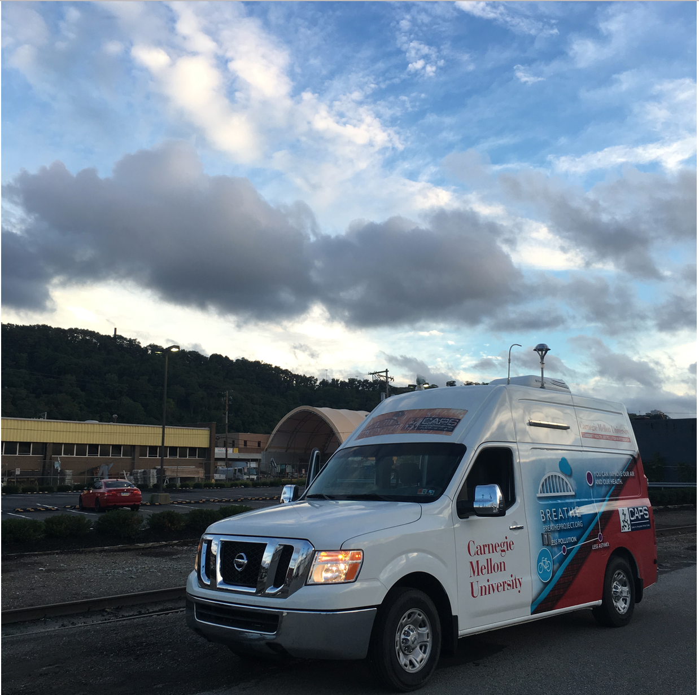
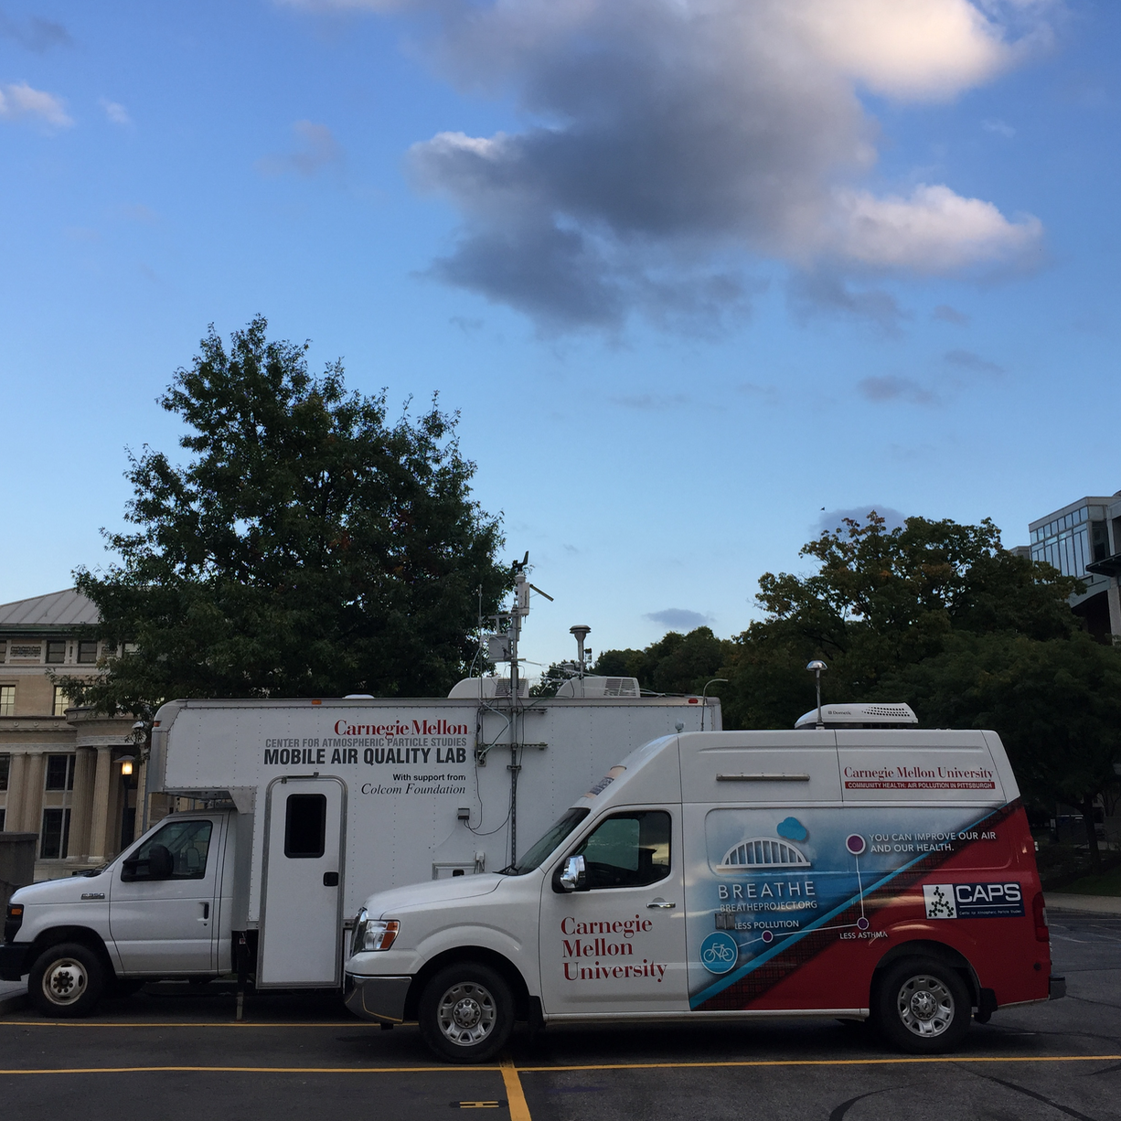
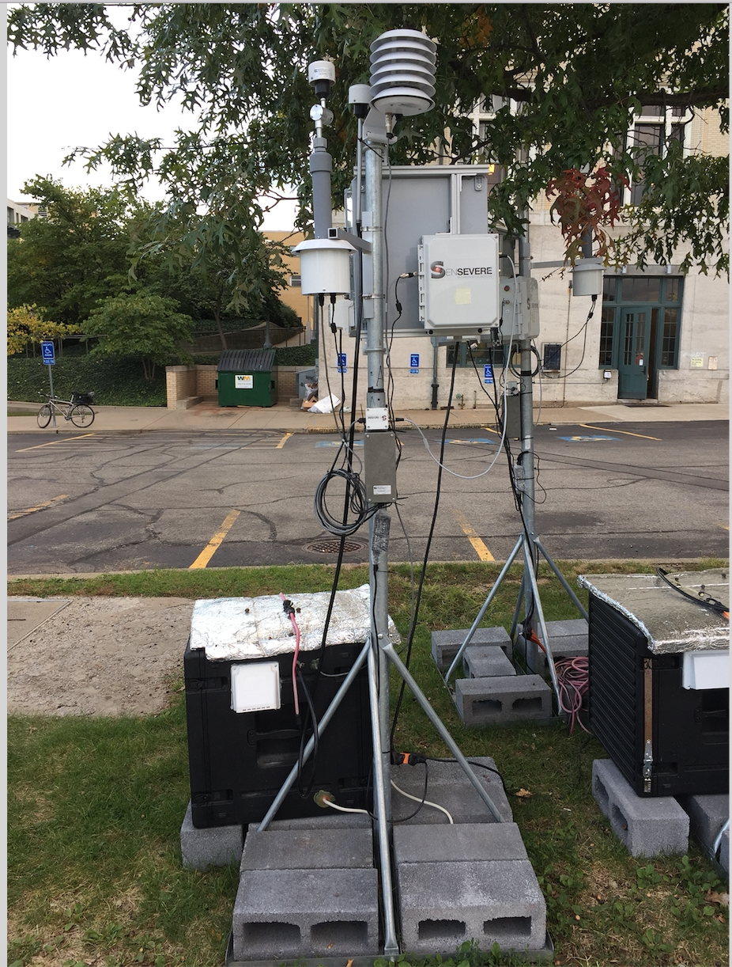
Center for Air, Climate and Energy Solutions
Mobile sampling
Supersite
Stationary monitors
Notes:
A center you feel proud to be part of

Slide 8
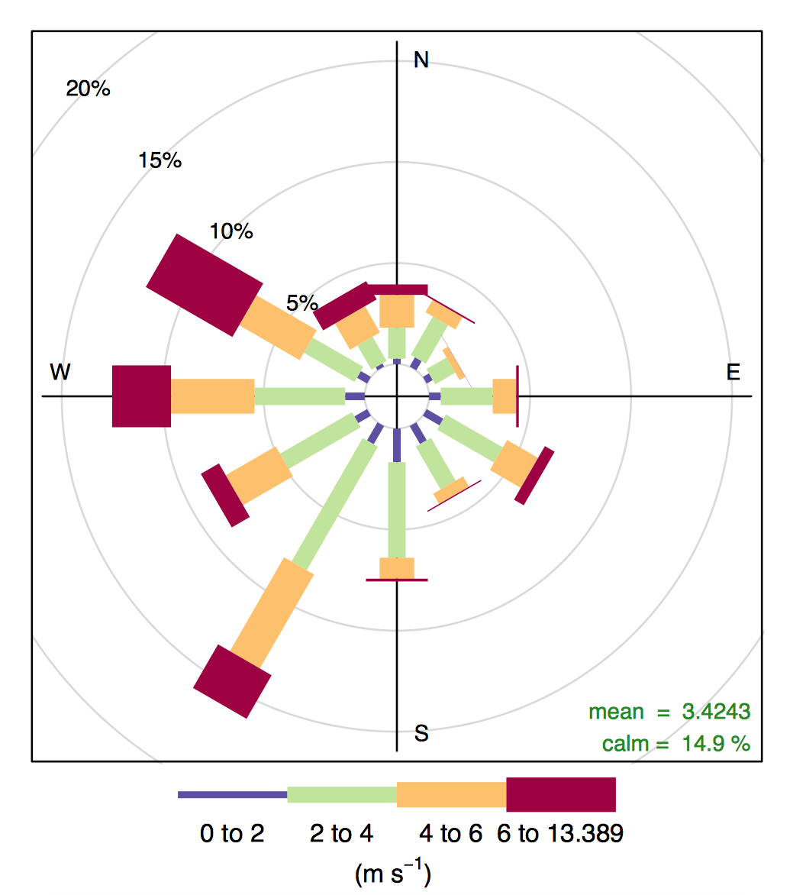
Mobile sampling around stationary monitors
Li et al., Submitted, 2018

Slide 9
What does mobile measure?
No2
Ufp
pm

Slide 10
What does stationary monitor measure?

Slide 11
Both mobile and stationary sampling describe similar pollutant gradient

Slide 12
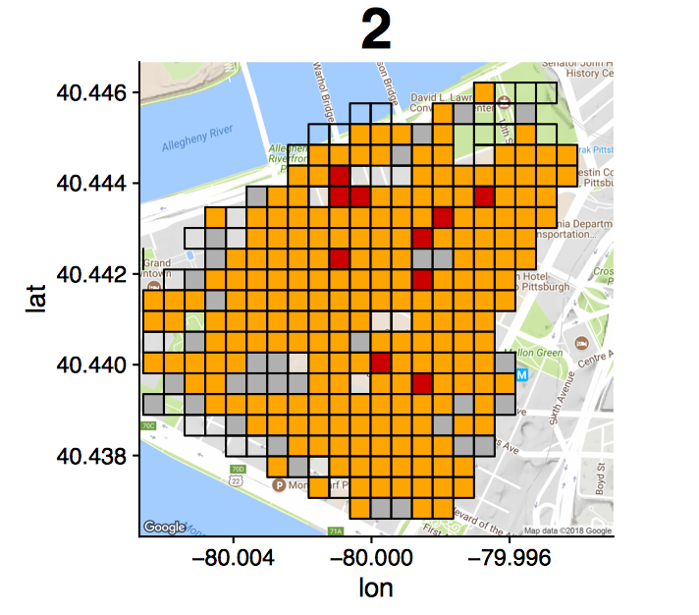
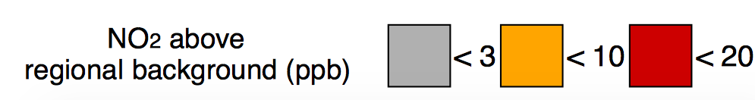
Downtown area 2 shows hyperlocal (~50 m) spatial variation
Notes:
NO2 regional background 7 ppb
Median enhancement, so less outlier effect

Slide 13
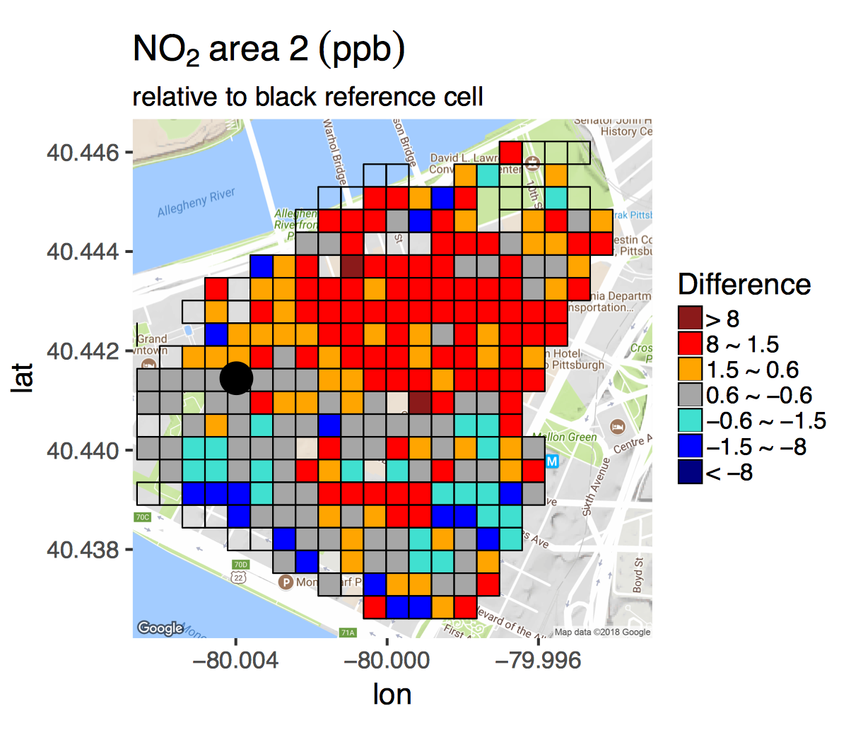
In urban areas, using one monitor to represent surrounding areas introduces bias for NO₂
13

Slide 14
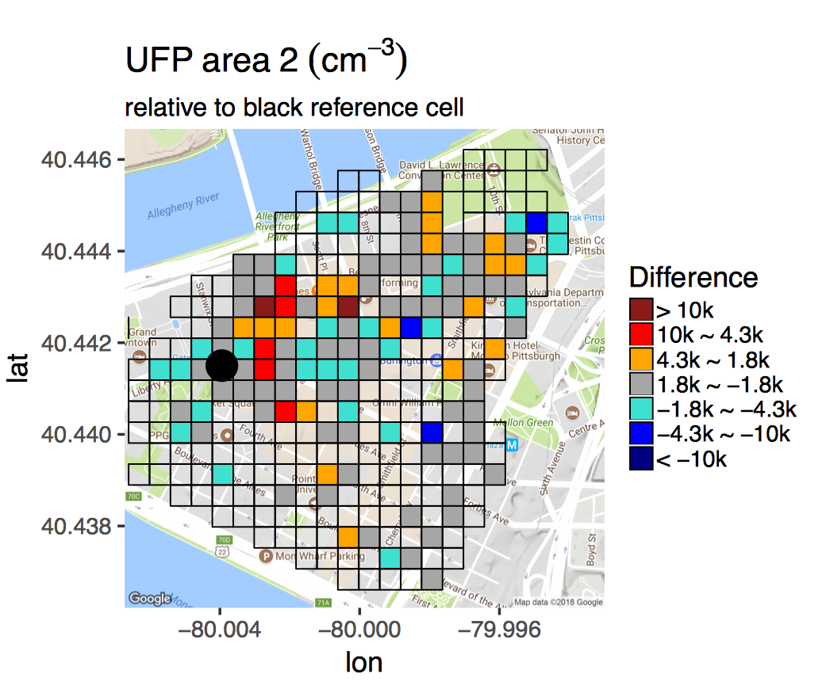
UFP is highly variable both spatially and temporally
Notes:
Grey boxes 1800/6200 = 30% of regional background

Slide 15
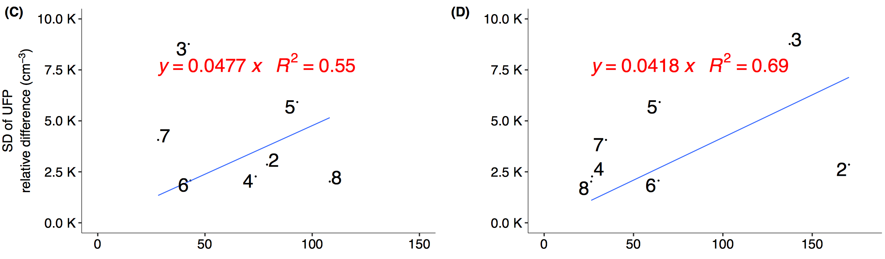
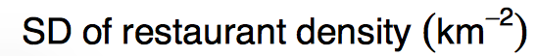
UFP spatial variation correlates with traffic and restaurant density
Notes:
Site 1 missing due to instrument vibration issue
This one describes the CTM issue

Slide 16
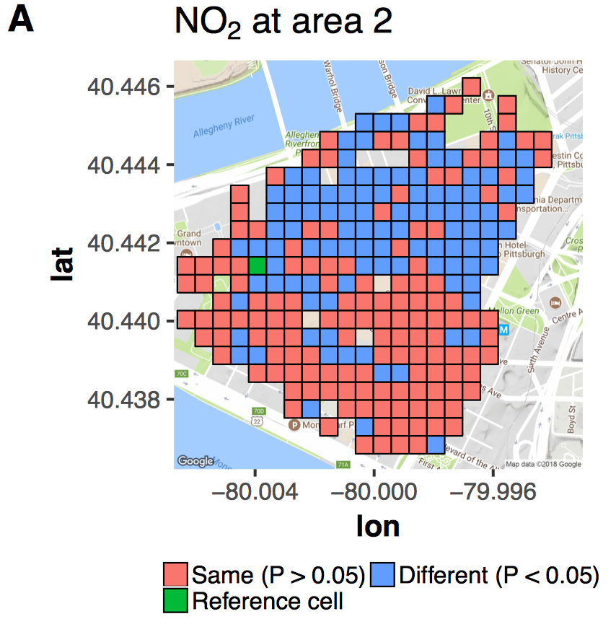
The reference cell statistically represents 60% of the whole 1 km² driving domain.
Notes:
Nonparametric Wilcoxon rank-sum test

Slide 17
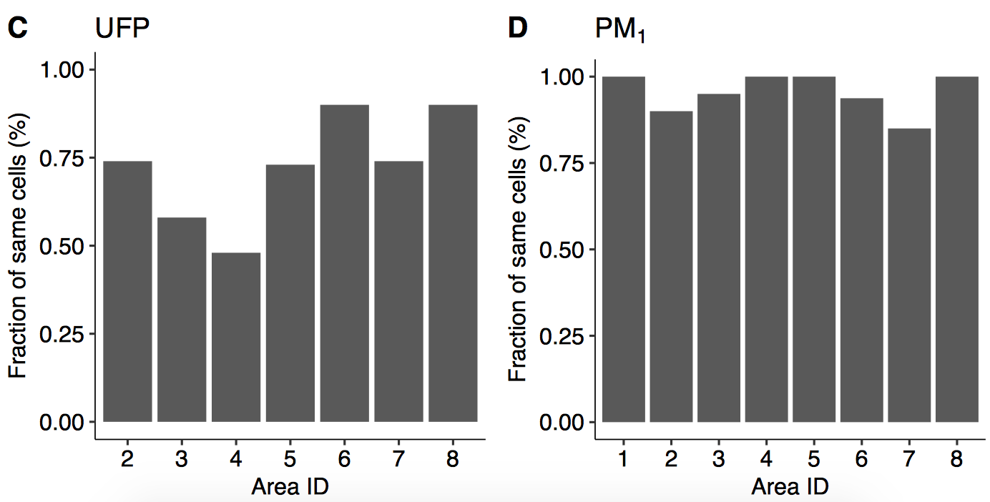
Urban monitors less spatially representative than suburb ones for UFP
Notes:
But for PM, they both ok

Slide 18
Conclusion

Slide 19

Thanks for your attention!
Prof. Albert A. Presto
Center for Atmospheric Particle Studies (CAPS)
Carnegie Mellon University, PA
apresto@andrew.cmu.edu
RD83587301
Photo courtesy of Xiang Li

Slide 20
NO₂ at urban areas more variable than suburbs
Notes:
Change color (urban) vs. suburbs

Slide 21
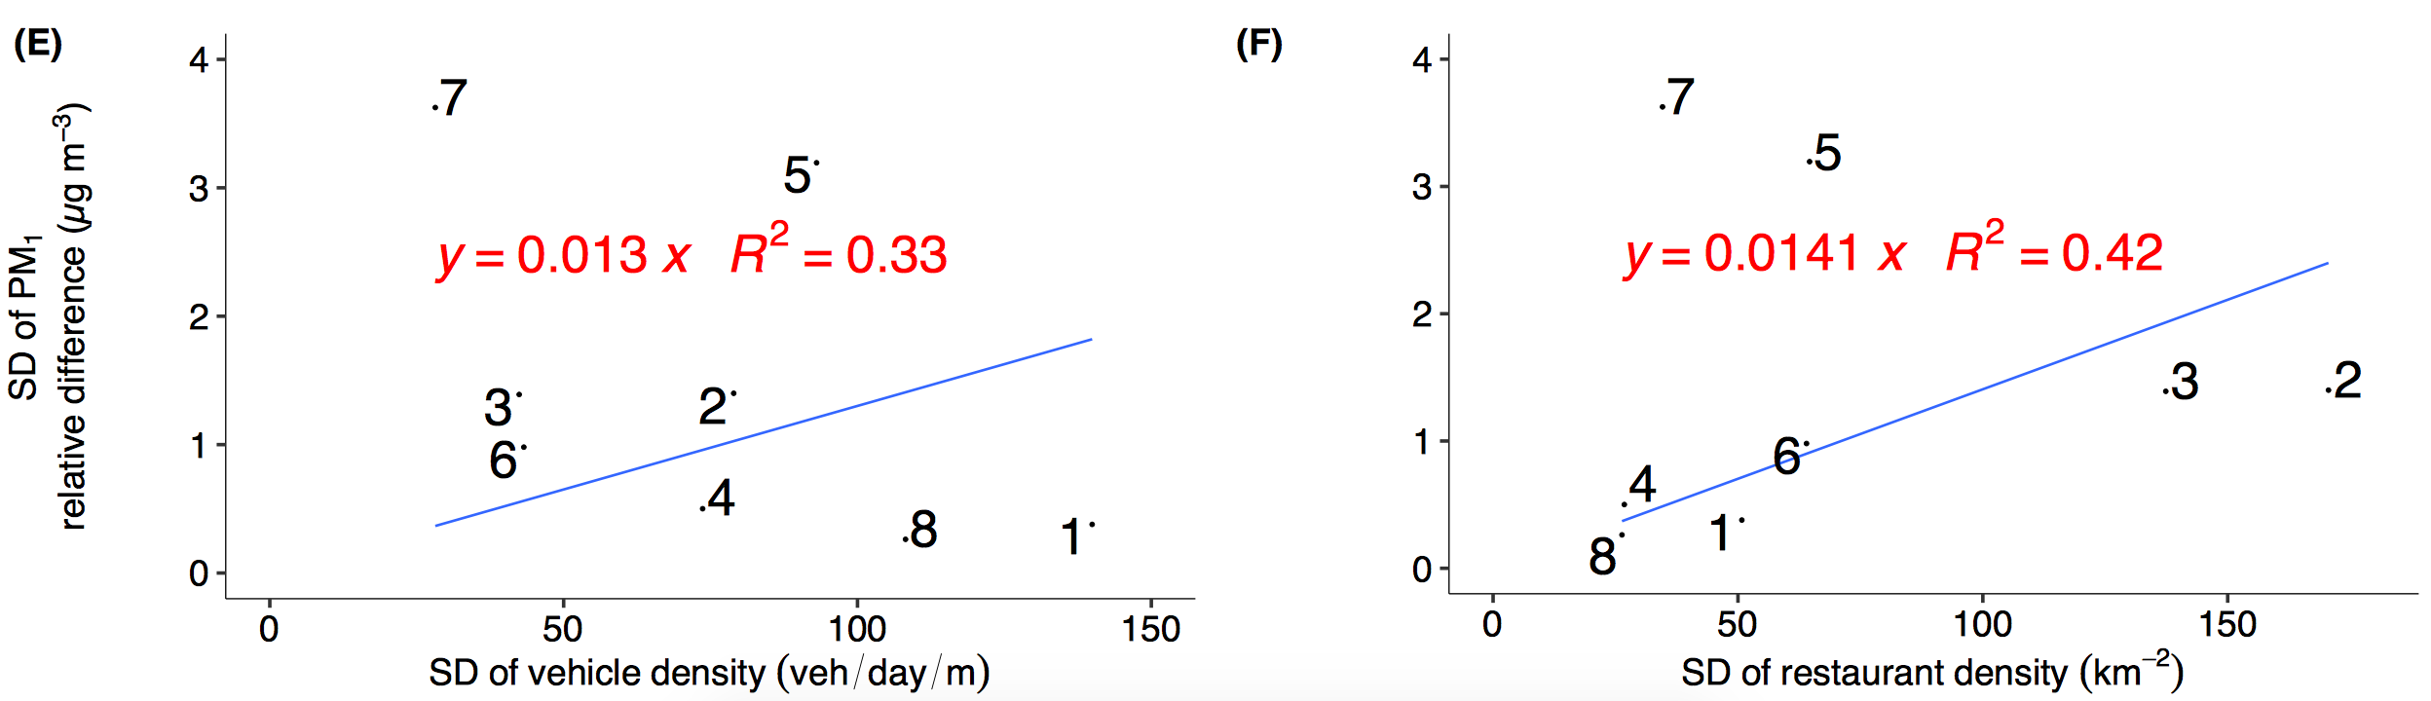
Secondary PM₁ worse correlation with traffic and restaurant

Slide 22
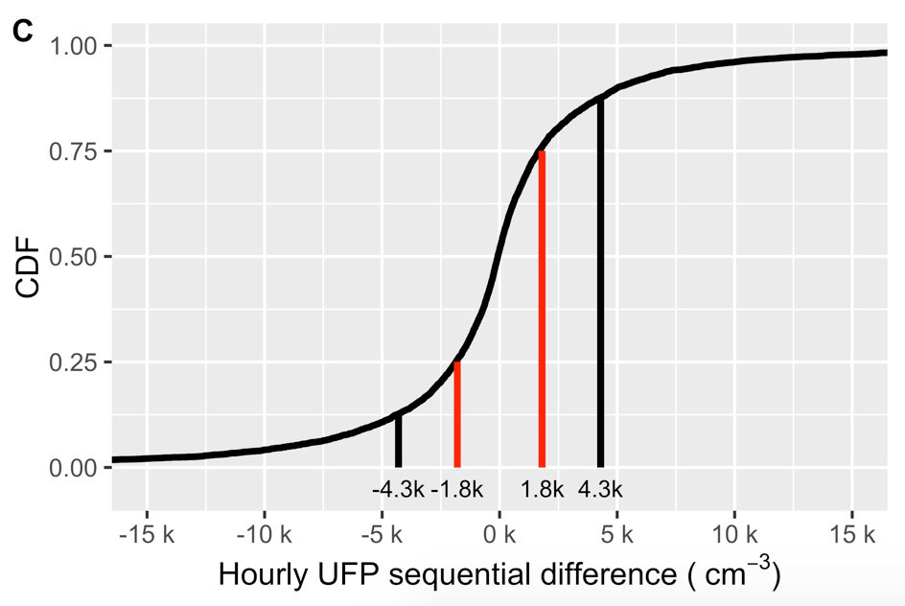
CDF of hour-to-hour UFP variation based on stationary monitors
Red: 50% range
Black: 75% range

